Slide 1
The discovery and preservation of art

Slide 2
Bellringer august 17
Finish 1.2 questions
What do archaeologists do? Describe their job and what all you think it requires.
Read/Scim over 1.3

Slide 3
Archaeology
It’s the study of evidence from past cultures by finding items hidden in the earth.
What are some things you think archaeologists may struggle with?
Once you find something, how do you date it or even tie it back to a certain culture?

Slide 4
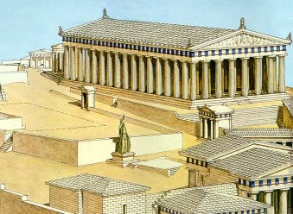
Parthenon-Athena temple

Slide 5
Museums
Museums play an important role in helping to collect and preserve art from all time periods.
What are some things you think museums struggle with?

Slide 6
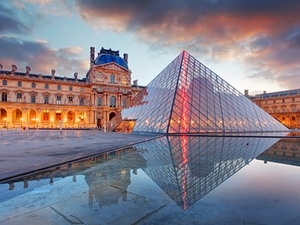
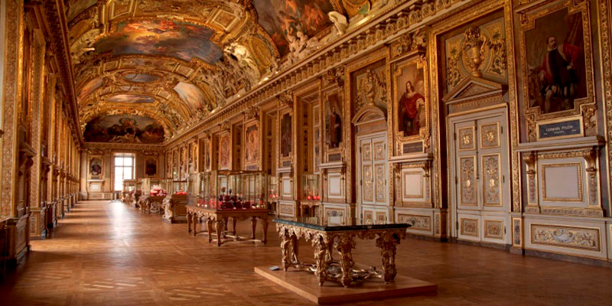
Louvre-Paris

Slide 7
How we study art
We study art by
Viewing it
Studying it
Creating it
Critiquing it

